Slide 2
High School Graduation
Requirements
and
Course Selections
Presentation

Slide 3
Administration
Mr. Everette Hare
Principal
Counseling Team
Ms. Yusheba Moses
Lead Counselor
12th grade & EC 9th -11th
Mrs. Christi Stewart
Counselor
10th grade K-Z
11th grade
Mrs. Ivette Colvin
Counselor
9th grade
10th grade A-J

Slide 4
What’s different from Middle School to High School
School Day:
Begins: 8:15 a.m.
End: 4:10p.m.
You must earn a certain number of credits to get promoted.
You must pass the required course and state assessments in order to graduate.

Slide 5
Earning Credits
Grade Level | Credits Required
9th | 0-5.5
10th | 6-12.5
11th | 13-17.5
12th | 18 and up
Graduation | 26 or more
Students earn 1 credit per 1-year long class with a semester grade of 70 or higher.
Students can earn up to 8 credits per year.
Most students graduate with more than 26 credits

Slide 6
Foundation High School Plan with Endorsement(s)
SUBJECT | Credits Required
English | 4.0
Mathematics | 4.0
Science | 4.0
Social Studies | 4.0
Foreign Language | 2.0
Fine Arts | 1.0
Physical Ed or Substitute | 1.0
Health | 0.5
Electives | 5.5
Total | 26.0
26 Credits Required for Graduation

Slide 7
Course Levels
Level
Basic College
Advanced
“Previously known as Pre-AP”
WEIGHTED GPA
A=4.0
More Rigorous College Prep Classes that prepare for AP Classes
Dual Credit
Advanced Placement
College level classes that earn both high school and college credit
WEIGHTED GPA
A=5.0
College level classes that earn college credit with a qualifying AP test score
3-4 hours HW per class period
WEIGHTED GPA
A=5.0
WEIGHTED GPA
A=5.0

Slide 8
Advanced Courses
Core Classes
9th Grade | 10th Grade | 11th Grade | 12th Grade
English I - Advanced Algebra I - Advanced Biology - Advanced Spanish III - Advanced | English II - Advanced Geometry - Advanced Chemistry - Advanced Spanish III - Advanced | Algebra II - Advanced Spanish III - Advanced Environment Sys - Adv | PreCalculus – Advanced
On Level is offered in all Core Classes

Slide 9
Advanced Placement (AP) Core
9th Grade | 10th Grade | 11th Grade | 12th Grade
AP Geography | AP World History AP Spanish IV | AP English III AP US History AP Music Theory AP Spanish III | AP English IV AP Government AP Economics AP Calculus AP Physics AP Spanish IV
College Credit is determined by college attending and by score on College Board AP Exam at the end of the course

Slide 10
Dual Credit
Guaranteed credit in State of Texas Public Colleges and Universities
Students must demonstrate college readiness with qualifying test scores:
11th Grade | 12th Grade | Elective Options 10th, 11th or 12th grade
English 3 (6 CCH) US History (6 CCH) College Algebra (3 CCH) CCH (college credit hours) | English 4 (6 CCH) US Government (3 CCH) Economics (3 CCH) PreCalculus (7 CCH) or Statistics (3 CCH) | Hospitality Service (3CCH) Hotel Mgt (3 CCH) Travel Tourism (3 CCH) Principles of Hospitality (3CCH) Practicum Hospitality Service (6 CCH) Public Speaking (3 CCH) Texas Government (3 CCH) Principles of Business Mgt (3 CCH)
PSAT 10/11:
Read=460+ Math=510+
or
STAAR English II EOC 4000+
Texas Success Initiative online test available on campus twice a year
Earn up to 52 college hours before you graduate!
TSI
Read=351
Math=350
Writ=340
4+ Essay
College Credit earned with a 70 or higher in the course

Slide 11
State Assessment (STAAR): Graduation Requirement
The following 5 end-of-course (EOC) assessments are required:
9th Grade | English I Algebra I Biology
10th Grade | English II
11th Grade | US History
You must pass each of the five EOC assessments to meet state graduation requirements.

Slide 12
Core Courses for 9th grade
English | Math | Science | Social Studies
Currently in Language Arts - 8th gr Choose English I or English I - Advanced | Currently in Math - 8th gr Choose Algebra I or Algebra I - Advanced | Currently in Science – 8th gr. Choose Biology or Biology - Advanced | Currently in Social Studies – 8th gr. Choose World Geography or Advanced Geography
Currently in English I Choose English II Or English II - Advanced | Currently in Algebra I Choose Geometry Or Geometry - Advanced

Slide 13
Additional Courses Needed
Language Other than English (LOTE) 2 Full years of the same language required | Language Other than English (LOTE) 2 Full years of the same language required
Currently enrolled in Spanish for Spanish Speakers Choose Spanish III | Currently enrolled in Spanish I Choose Spanish II
Currently not enrolled in LOTE Class Choose Spanish I
Fine Arts 1 full year required
Currently enrolled in High School Art I Choose Art II
Currently not enrolled in Fine Arts Choose Art I Theater I Dance I Marching Band

Slide 14
Physical Education/Athletics
1 full year of credit required
Physical Education
Individual Team Sports
Foundation of Personal Fitness
Aerobics Activities
Try Outs Required
Athletes playing 2 sports should choose the sport that comes first in the school year.
Athletics
Baseball
Basketball
Cross Country Track
Football
Soccer
Track
Volleyball
Cheerleading
Dance Team
Marching Band
Tryouts are required for most sports.
Coaches will evaluate student placement over the summer.
Incoming 9th graders can sign up for the sport of their choice.

Slide 15
What is an Endorsement?
It’s an Investment in the personal part of a student’s high school experience.
Endorsements are known as “Majors” in college – the subjects that students are most interested in.
The classes specialize in knowledge and skills to prepare students for higher education and careers!
To fulfill the graduation requirement of an Endorsement, you must have 4 credits in your selected career pathway.
Many industry certifications and licenses are available through CTE courses. Talk to a CTE instructor or see the SISD Educational Planning Guide for more information.

Slide 16
Types of Careers For Business
Accountant
Automotive Technician
Banker
Film Editor
Mechanic
Pilot/Flight Attendant
Plumber
Graphic Designer
Veterinarian
Video Game Designer
Web Designer
Welder
Pathways We Offer
Money Matters
Graphic Design
Principles of Business Management
Web Development
Endorsement

Slide 17
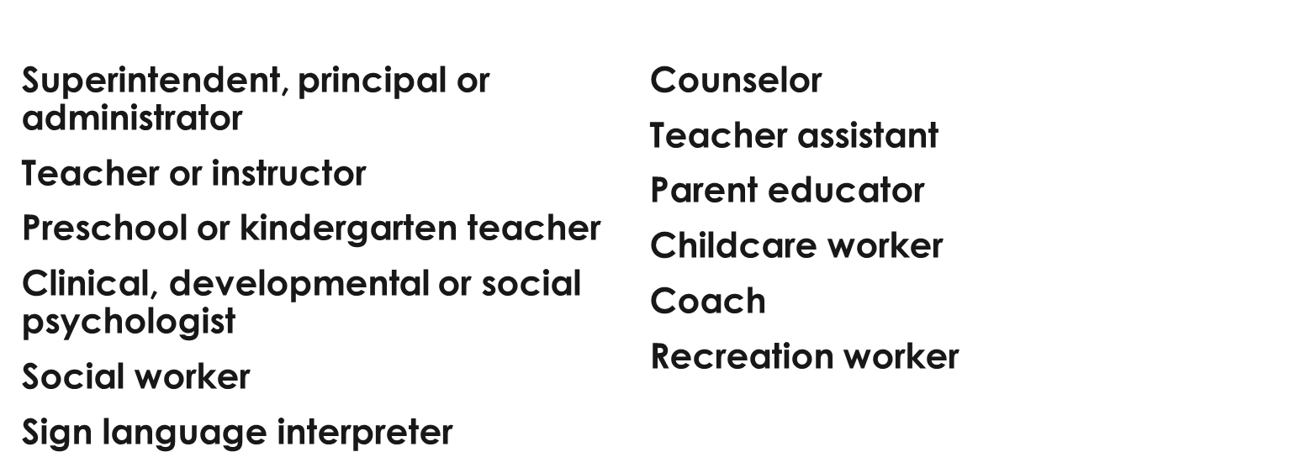
Types of Careers for Education

Slide 18
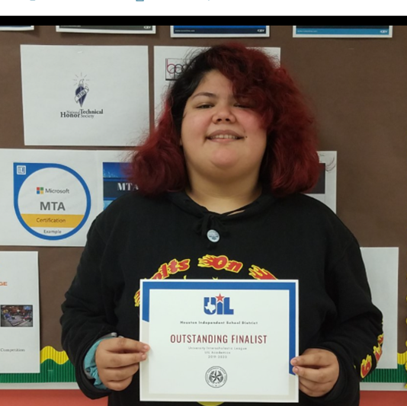
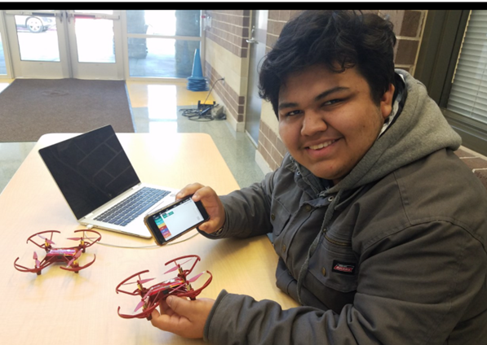
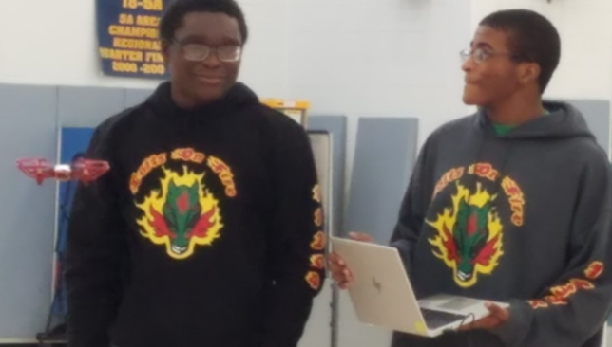
Information Technology (IB Program)
Principles of Information Technology
Robotics
Drones
Project Resolution
Web Design
Web Games
Endorsement

Slide 20
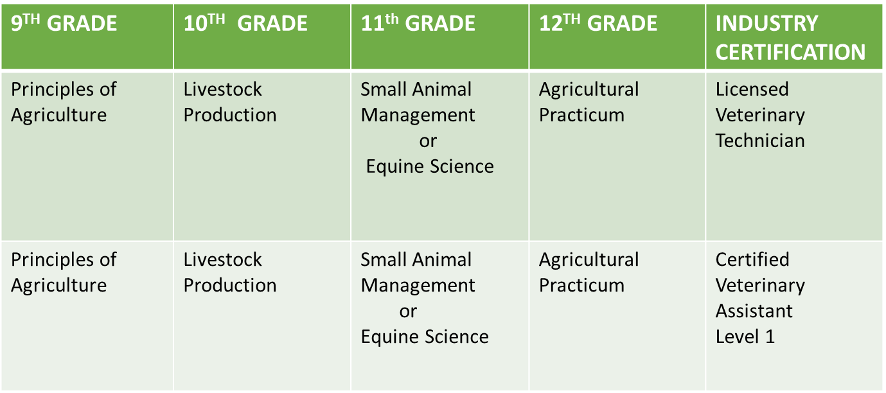
AGRICULTURE, FOOD & NATURAL RESOURCES

Slide 21
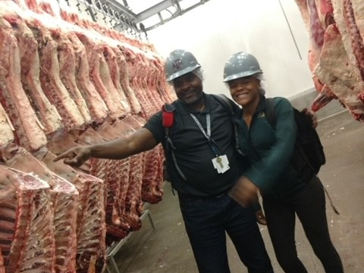
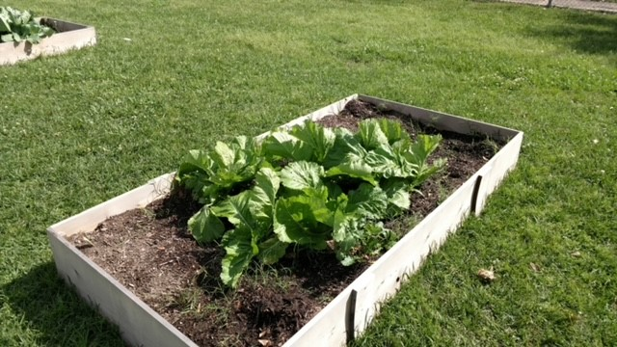
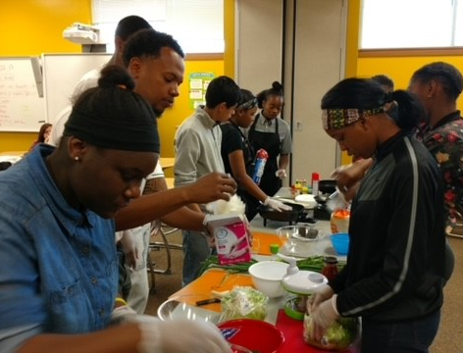

Slide 22
Marketing/Hotel Management
Course Sequence:
Principles of Hospitality and Tourism
Hotel Management
Travel and Tourism Management
Practicum in Hospitality Services
OSHA 30 certification

Slide 23
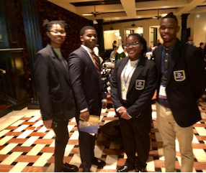
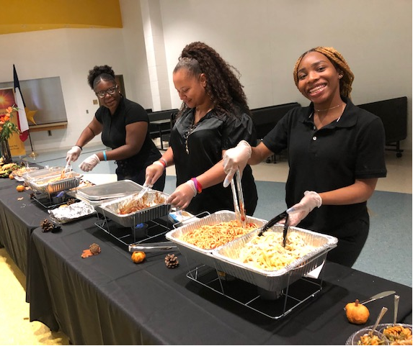
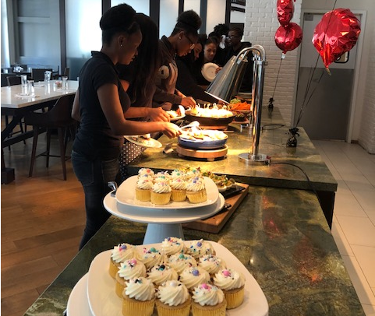
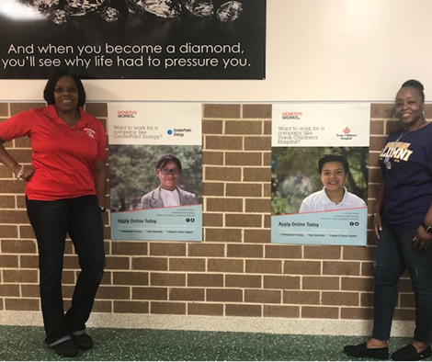
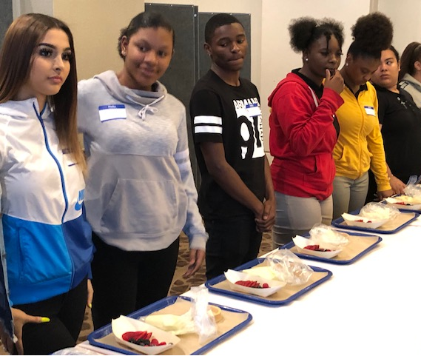

Slide 24
Dual Credit
A partnership between Houston ISD and Houston Community College
Texas Education Agency Early College Blueprint
Earn College Credits in High School - FREE OF CHARGE

Slide 26
Course Snapshot:
1321 Introduction to Hospitality Industry
Front Office Management
1325 Purchasing for Hospitality Operations
1324 Hospitality Human Resources Management
1340 Hospitality Legal Issues
Introduction to Accounting I
2305 Hospitality Management & Leadership
2307 Hospitality Marketing & Sales
Dual Credit Courses - Hospitality Administration

Slide 27
Types of Careers for
Arts and Humanities Endorsement
Actor
Artist
Choreographer
Dancer
Historian
Make-up Artist
Movie Producer
Musician
Photographer
Radio/TV Announcer
Singer
Writer
Click on the pathways that we offer to check the classes you would take
Pathways We Offer
Instrumental Performance
Theatre
Vocal Performance
Visual Arts
Dance
Endorsement

Slide 28
What is
Multidisciplinary Studies?
A Coherent sequence of courses selected from on e of the following:
4 advanced courses from other endorsement areas
4 credits in each of the four foundation subject areas to include English IV and chemistry and/or physics
4 credits in AP, dual credit selected from English, mathematics, science, social studies, economics, language other than English, or fine art
Endorsement

Slide 29
Pick your Path

Slide 30
Course Selection
Worthing Early College HS Counselors will be available to assist with completing your Google form.

Slide 32
Transformation begins with
YOU
We’re In
Are you In?

